Slide 1
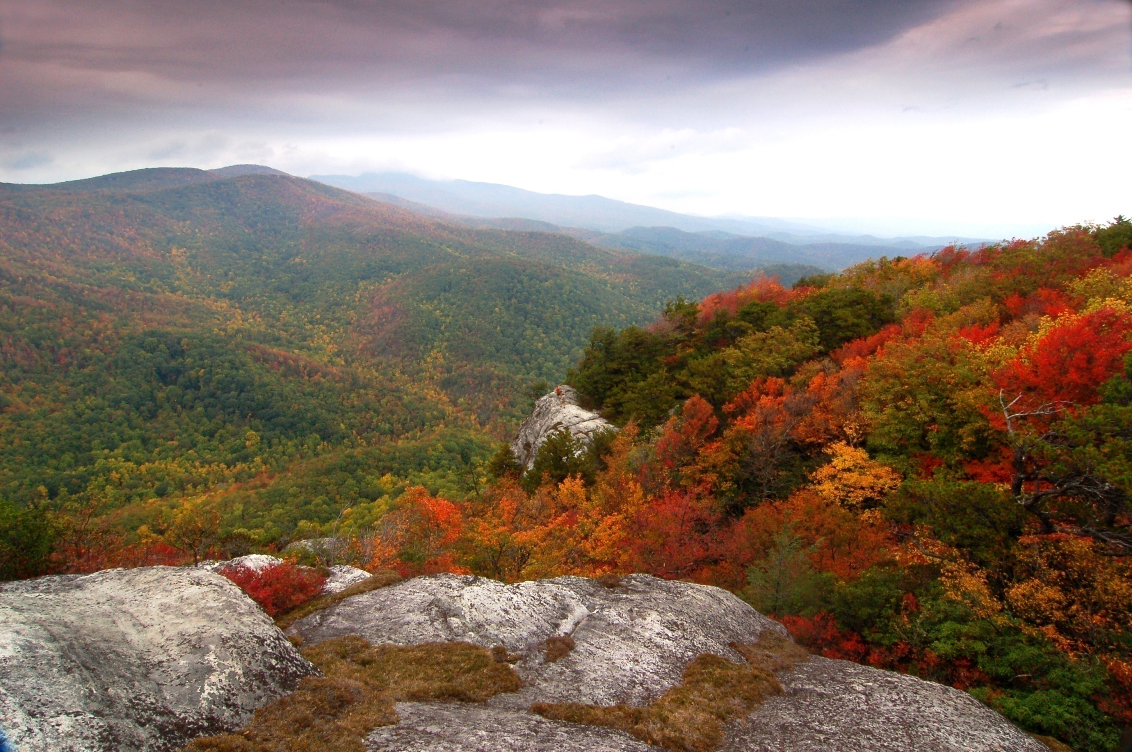
Appalachia
Notes:
In this lesson we tackle perhaps the greatest geological story of the entire course – the geological evolution of the Appalachian Mountains. The Appalachians may not be as topographically striking as the much younger mountains of the western states (Grandfather Mountain, NC) …

Slide 2
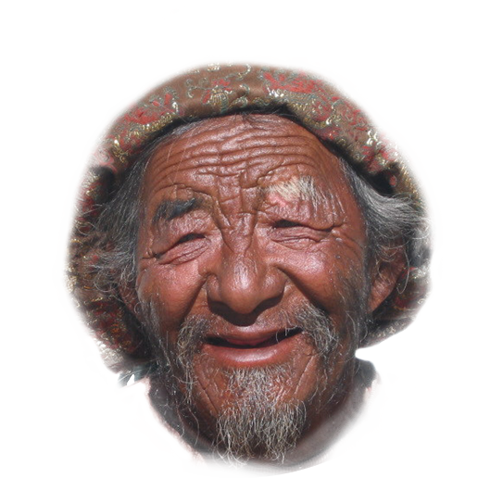
Notes:
… but like the face of an old man, they record a lot of history. The long, complex history of the Appalachians is made especially difficult to interpret because unlike the generally arid parks of the west, …

Slide 3
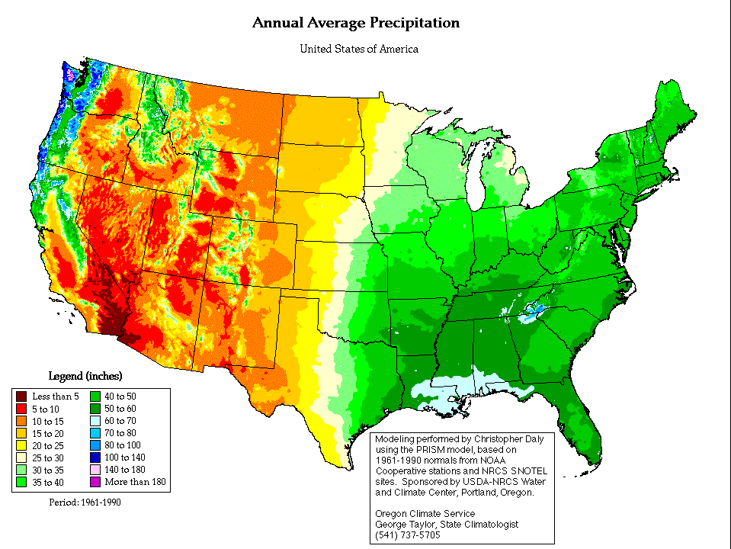
Notes:
… the Appalachians receive quite a bit more precipitation.

Slide 4
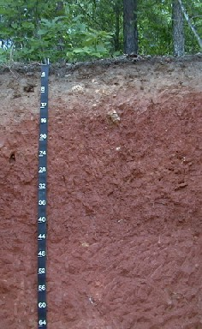
Notes:
So deep soils form …

Slide 5
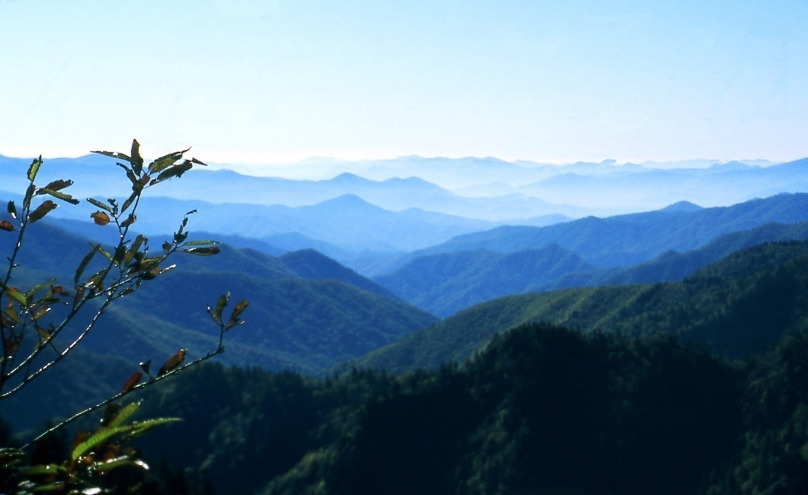
Notes:
… and rock outcrops are rare. I once spent a summer working as a geologist on a gold prospect in the Blue Ridge of Virginia. Typically I’d only come across two or three outcrops a in a whole day of mapping!

Slide 6
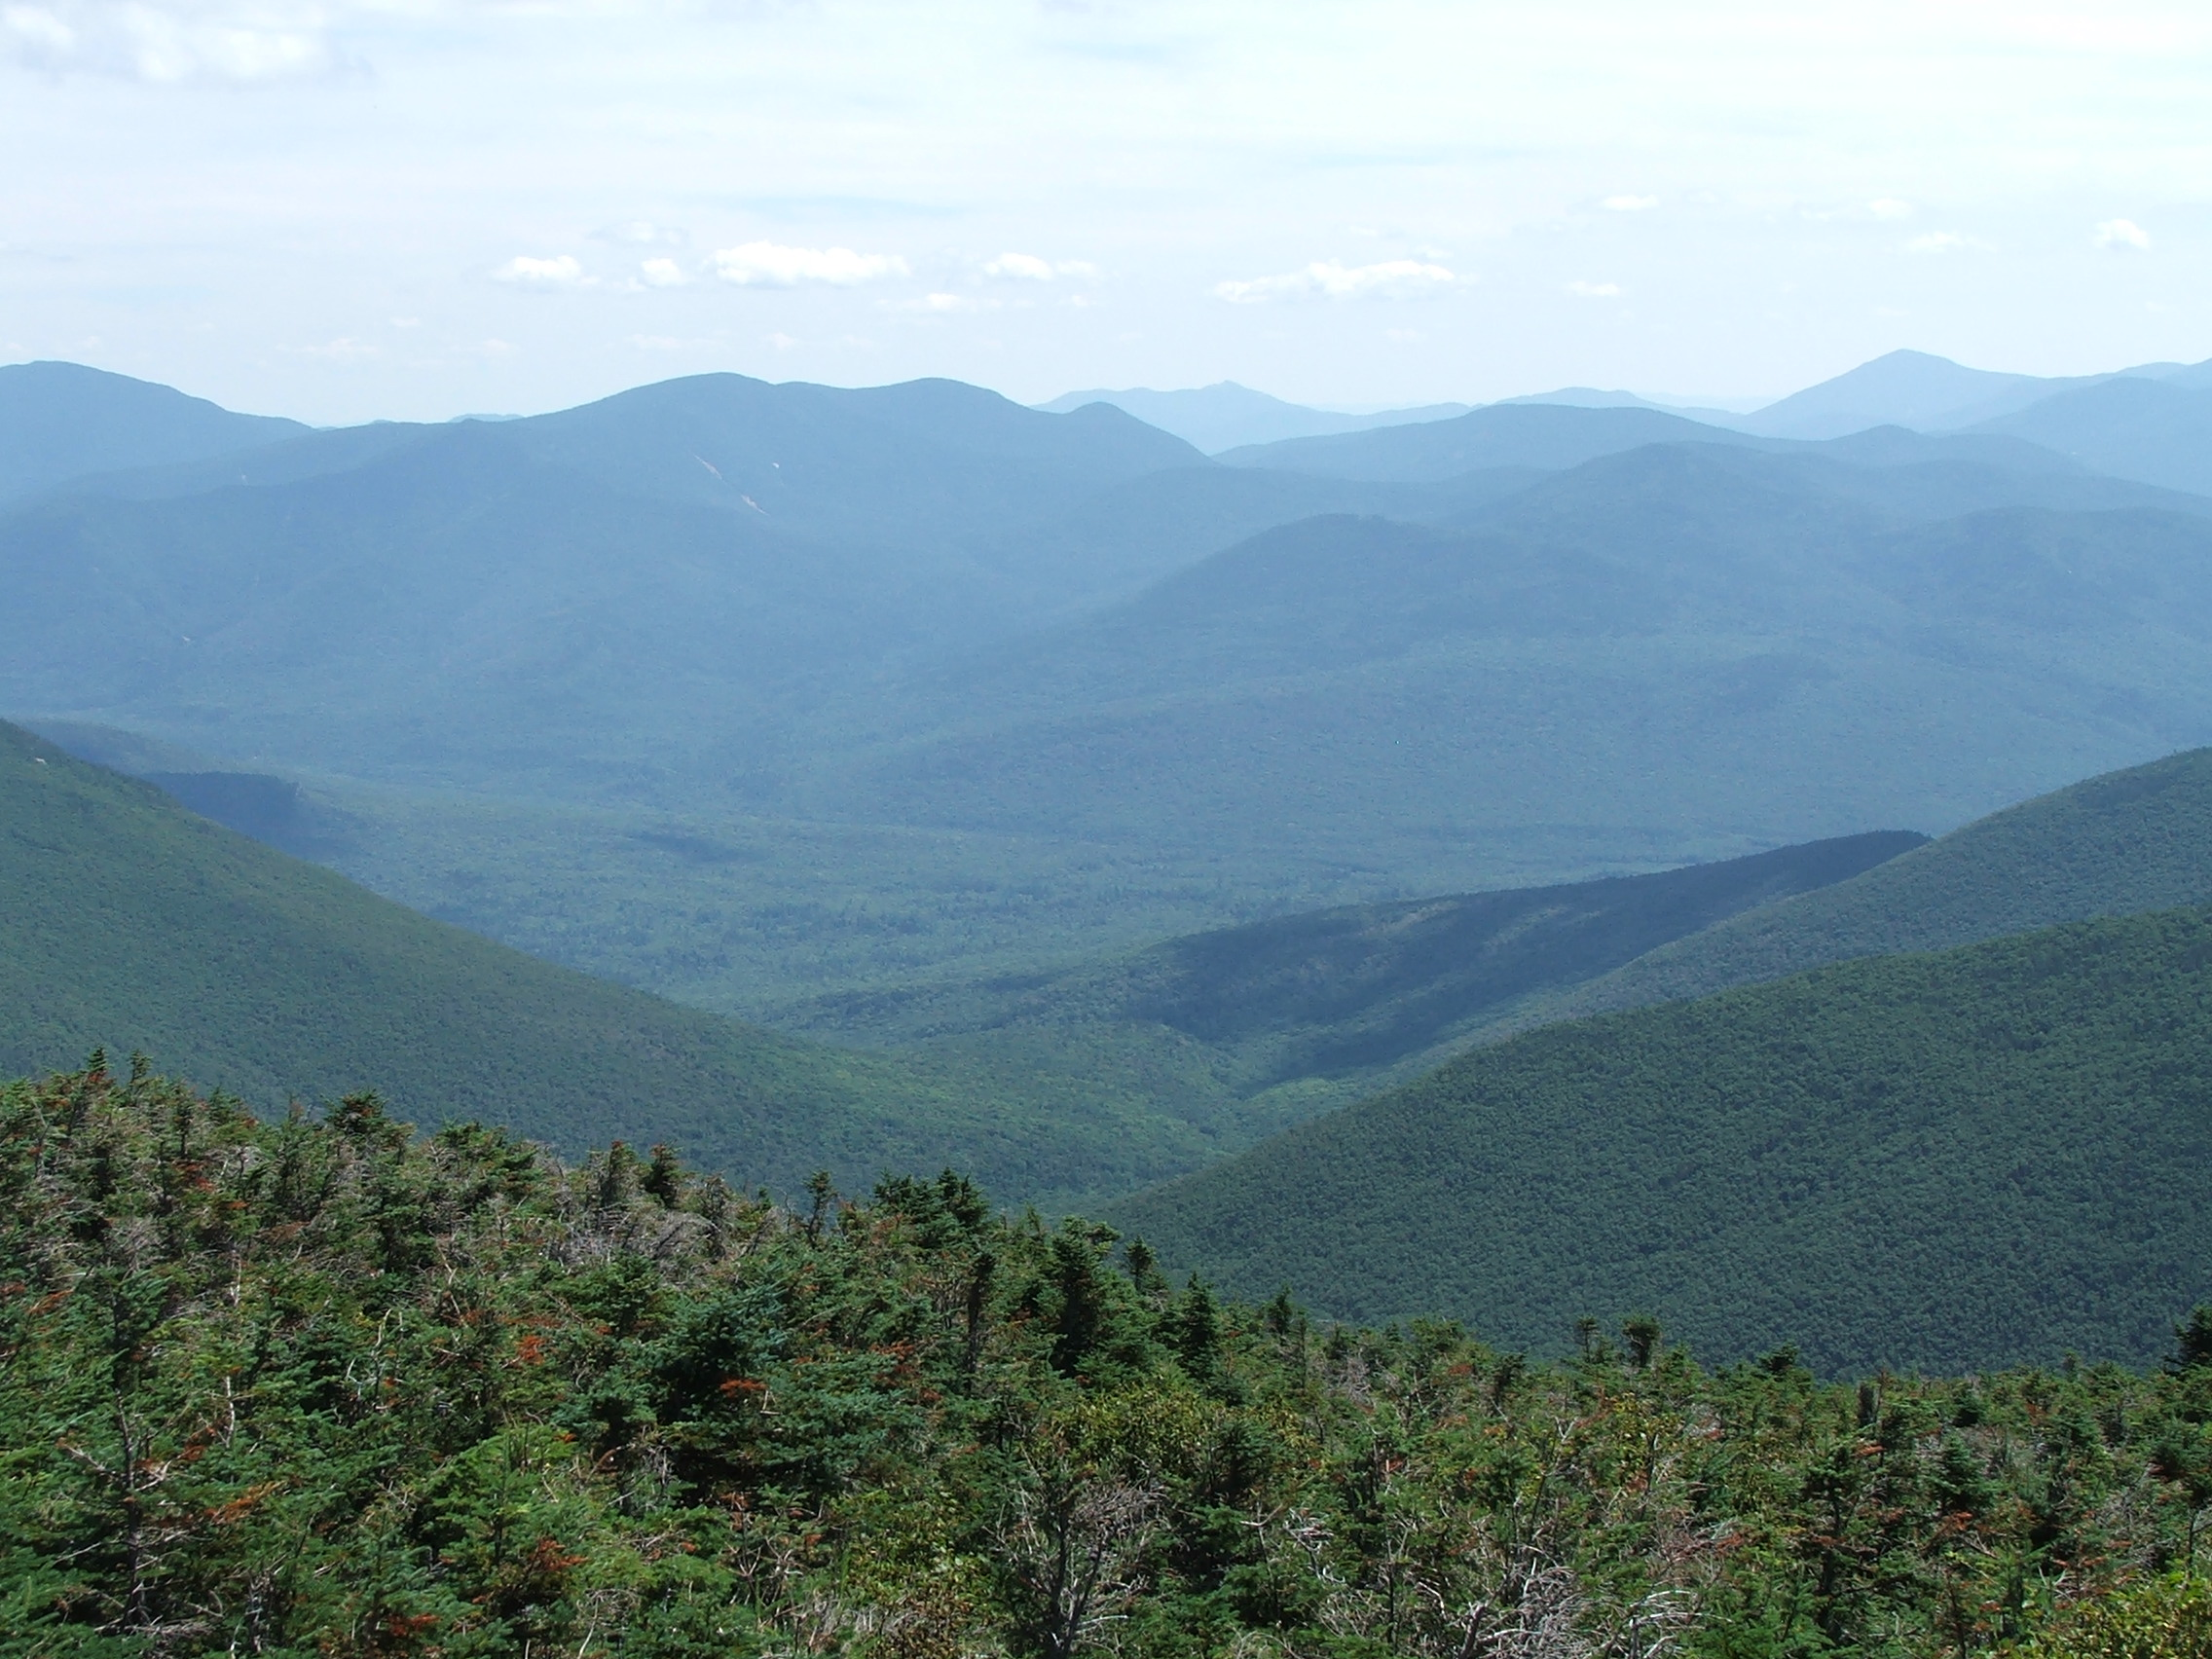
Notes:
So it just amazes me that geologists were able to work out the details of how these mountains evolved.

Slide 7
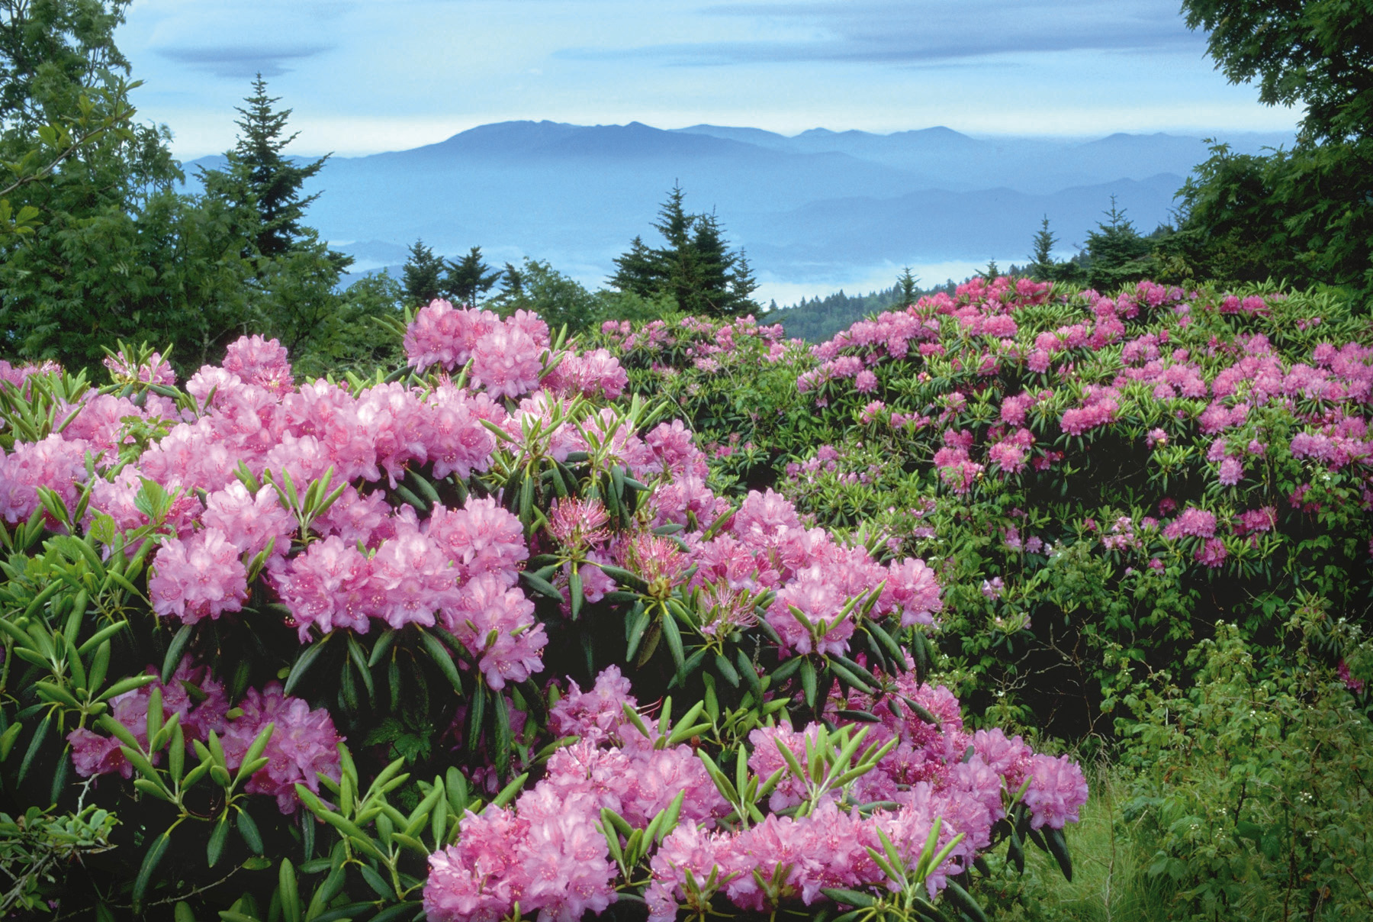
Notes:
Because rock exposures are so limited (stupid plants!), …

Slide 8
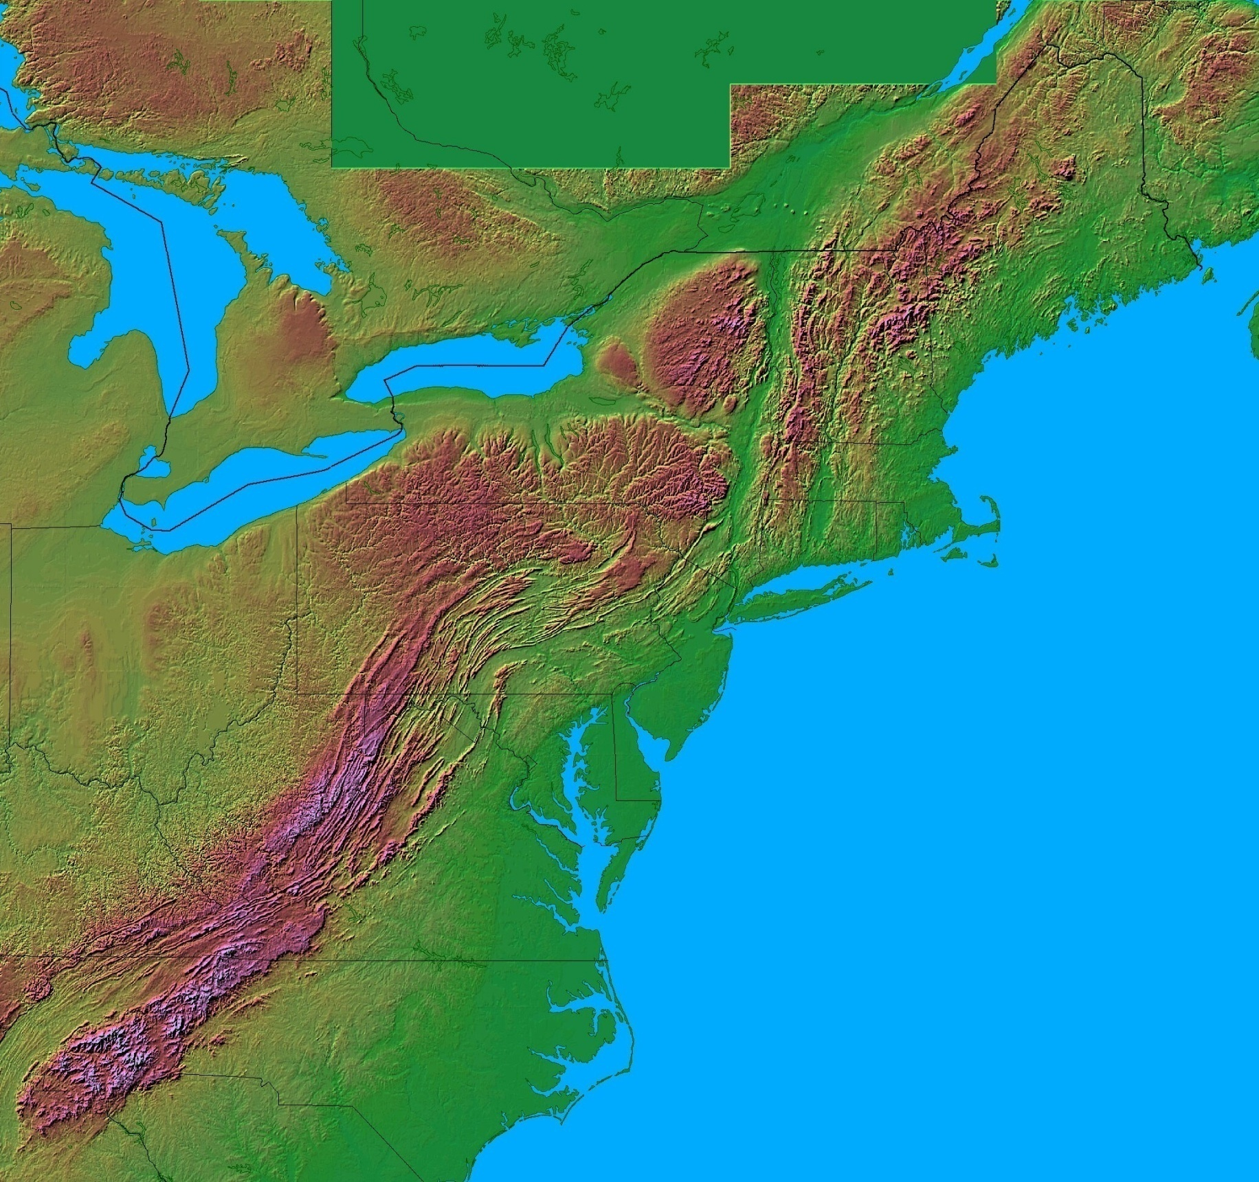
Acadia
Shenandoah
Appalachian National Parks
Great Smokey
Notes:
… and the three National Parks in the region – Acadia, Shenandoah and Great Smokey …

Slide 9
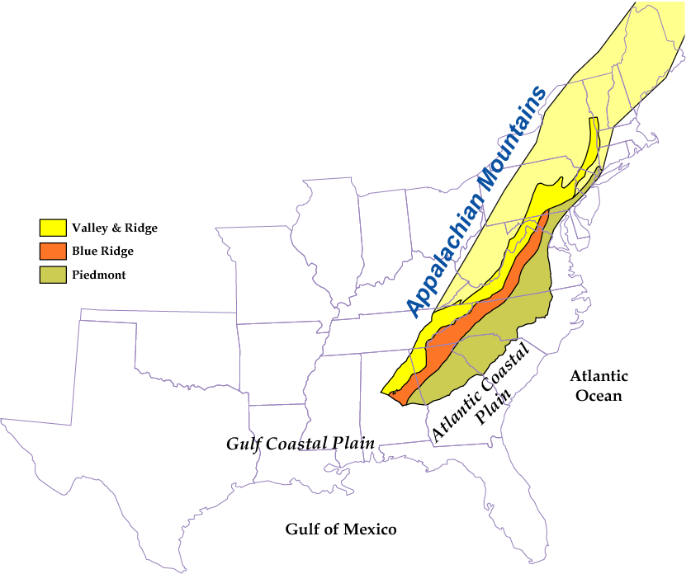
ANCIENT COLLISIONAL MOUNTAIN RANGE
Acadia
Shenandoah
Great Smokey
Parks and Plates
©2005 Robert J. Lillie
Notes:
… each fall within a different tectonic province and thus record only a portion of the Appalachian’s history, we are not going to study each park separately like we have done thus far in the course. We will instead take the discontinuous rock records from each park (and a few neighboring areas) and weave them together into a nearly continuous tapestry of time for the entire region.

Slide 10
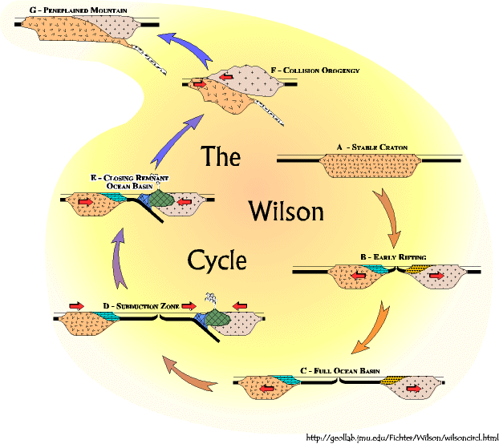
Notes:
The story will cover almost two complete Wilson Cycles ...

Slide 11
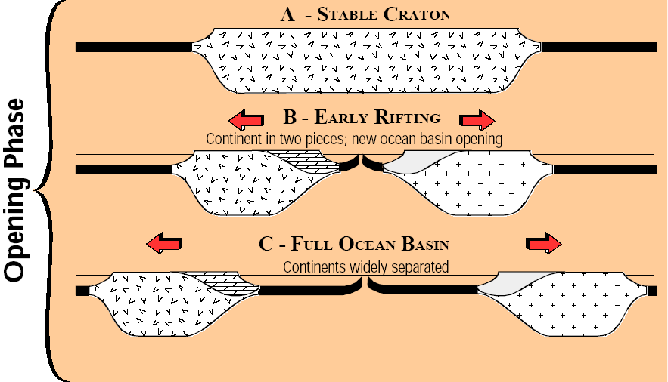
Notes:
… each of which consisting of two phases – an opening phase where a supercontinent rifts apart to form an ocean basin; …

Slide 12
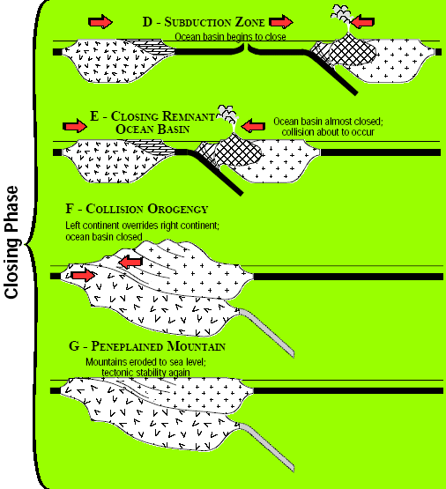
Notes:
… and a closing phase where continental fragments move towards one another, destroy an ocean basin and ultimately collide to form a new supercontinent.

Slide 13
Rifting
DCM Sedimentation
Opening
Notes:
In the opening phase, rifting produces two divergent continental margins, on top of which thick sequences of sediment accumulate.

Slide 14
Rifting
DCM Sedimentation
Subduction Orogeny
+/- Terrane Accretion
Collision Orogeny
Peneplanation
Opening
Closing
Notes:
In the closing phase the intervening ocean basin subducts (often accompanied by the accretion of one or more terranes) and eventually the rifted continents reunite in collision orogenies that build Himalayan-scale mountains that ultimately erode to a form a vast peneplane. Appalachian rocks record a complete Wilson Cycle like this …

Slide 15
Closing
Collision Orogeny
Peneplanation
Rifting
DCM Sedimentation
Subduction Orogeny
+/- Terrane Accretion
Collision Orogeny
Peneplanation
Opening
Closing
Notes:
…preceded by the end of the closing phase of an older Wilson Cycle …

Slide 16
Closing
Collision Orogeny
Peneplanation
Rifting
DCM Sedimentation
Subduction Orogeny
+/- Terrane Accretion
Collision Orogeny
Peneplanation
Rifting
DCM Sedimentation
Opening
Closing
Opening
Notes:
… and followed by the opening phase of a younger Wilson Cycle.

Slide 17
Great Smokey
Shenandoah
Acadia
Closing
Collision Orogeny
Peneplanation
Rifting
DCM Sedimentation
Subduction Orogeny
+/- Terrane Accretion
Collision Orogeny
Peneplanation
Rifting
DCM Sedimentation
Opening
Closing
Opening
Notes:
Each Appalachian park tells different portions of the story and with varying detail.

Slide 18
Great Smokey
Shenandoah
Acadia
Closing
Collision Orogeny
Peneplanation
Rifting
DCM Sedimentation
Subduction Orogeny
+/- Terrane Accretion
Collision Orogeny
Peneplanation
Rifting
DCM Sedimentation
Opening
Closing
Opening
Notes:
Acadia National Park will receive special mention for recording Quaternary glacial and coastal processes. Let’s begin with Shenandoah National Park since it has the best rock record of the initial collision orogeny.

Slide 19
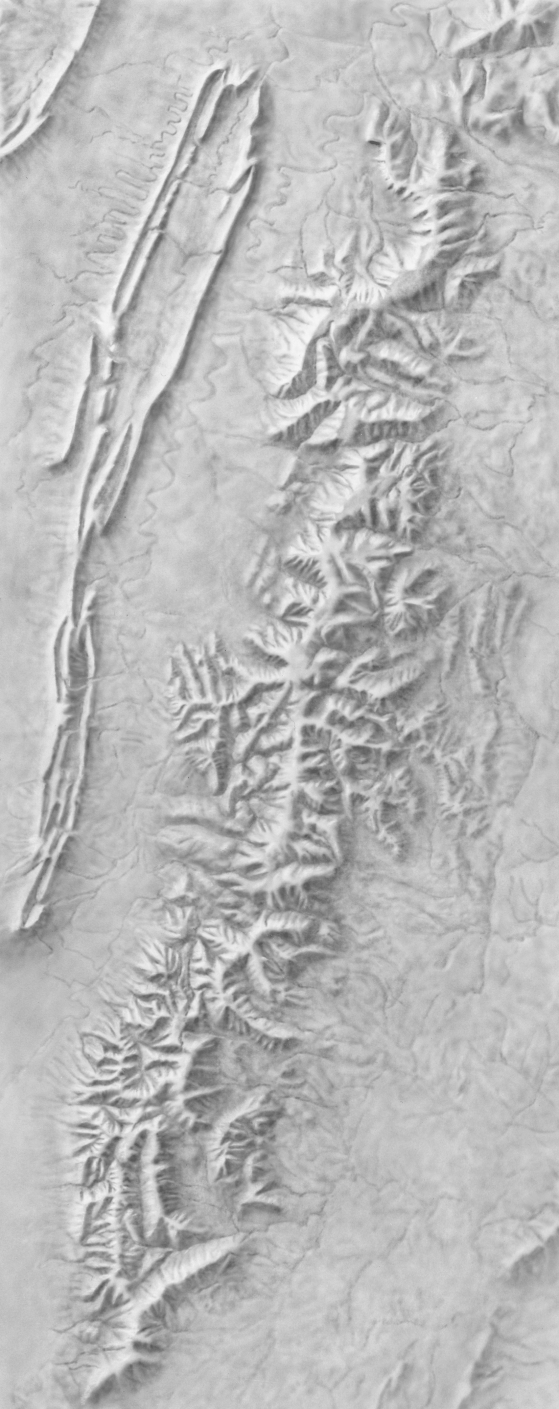
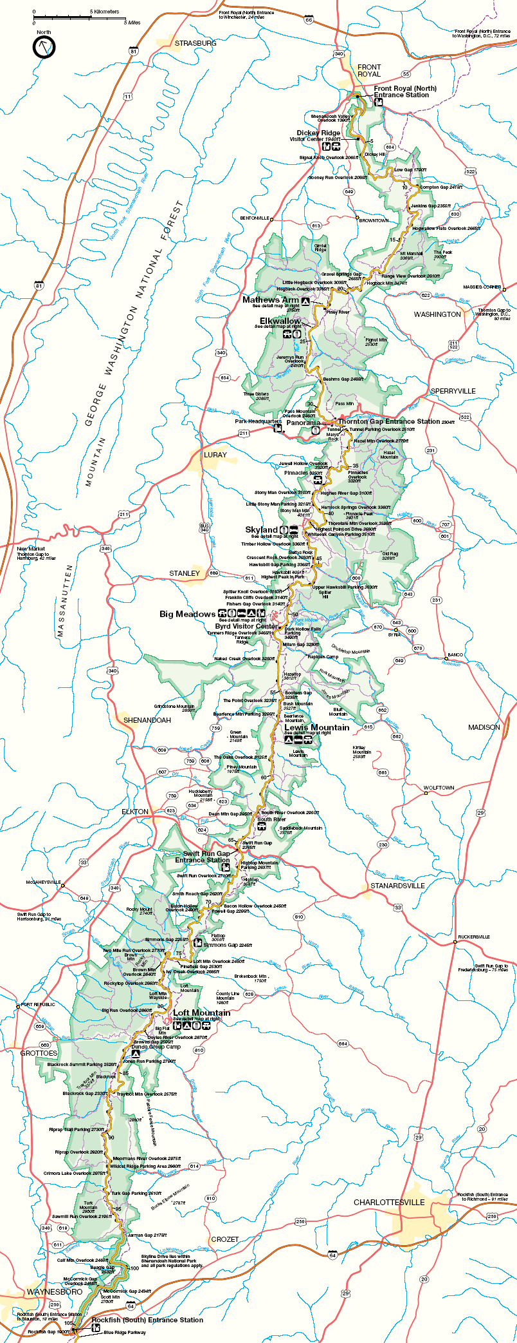
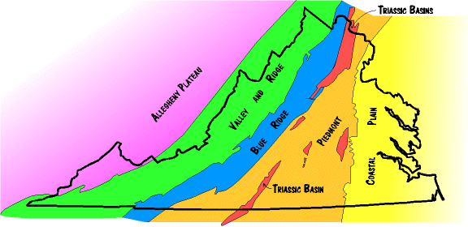
Shenandoah N.P.
Notes:
Located in Northern Virginia, Shenandoah National Park stretches-out along a 75 mile long portion of the Appalachian’s backbone – the Blue Ridge.

Slide 20
Southern Appalachian Mountains
Marshak, EARTH (Norton, 2005)
Parks and Plates
©2005 Robert J. Lillie
Notes:
Recall that the Blue Ridge represents the “hard” igneous and metamorphic basement of North America thrust over the folded and thrust faulted DCM sediments of the Valley and Ridge province.

Slide 21
Southern Appalachian Mountains
150 miles
Marshak, EARTH (Norton, 2005)
Parks and Plates
©2005 Robert J. Lillie
Notes:
By some estimates, thrust faulting moved these rocks about 150 miles westward from their pre-thrust location. Thrust faults are formed by compression, and so are folds, so it should make sense that Blue Ridge rocks are folded as well as well as faulted.

Slide 22
Overturned Anticline
Notes:
In Shenandoah National Park, the thrusted block of hard crust is bent into a giant overturned anticline.

Slide 23
Overturned Anticline
Notes:
Anticline because the sloping layers tilt away from (or anti) the center of the fold, …

Slide 24
Overturned Anticline
older
younger
Notes:
… and overturned because younger rocks on the fold’s western limb have been folded under older rocks in the core of the anticline - in flagrant disregard of the principle of superposition!

Slide 25
Overturned Anticline
Metamorphosed basalt
Paleozoic sedimentary rocks
Gneiss and granite
Notes:
The oldest rock is the 1.3 billion year old Pedlar gneiss. It is intruded by the Old Rag granite which radiometrically clocks in at about a cool billion years old. Resting nonconformably above these Proterozoic crystalline basement rocks lie the late Proterozoic Catoctin Formation (mostly metamorphosed basalt) and folded Paleozoic sedimentary rocks.

Slide 26
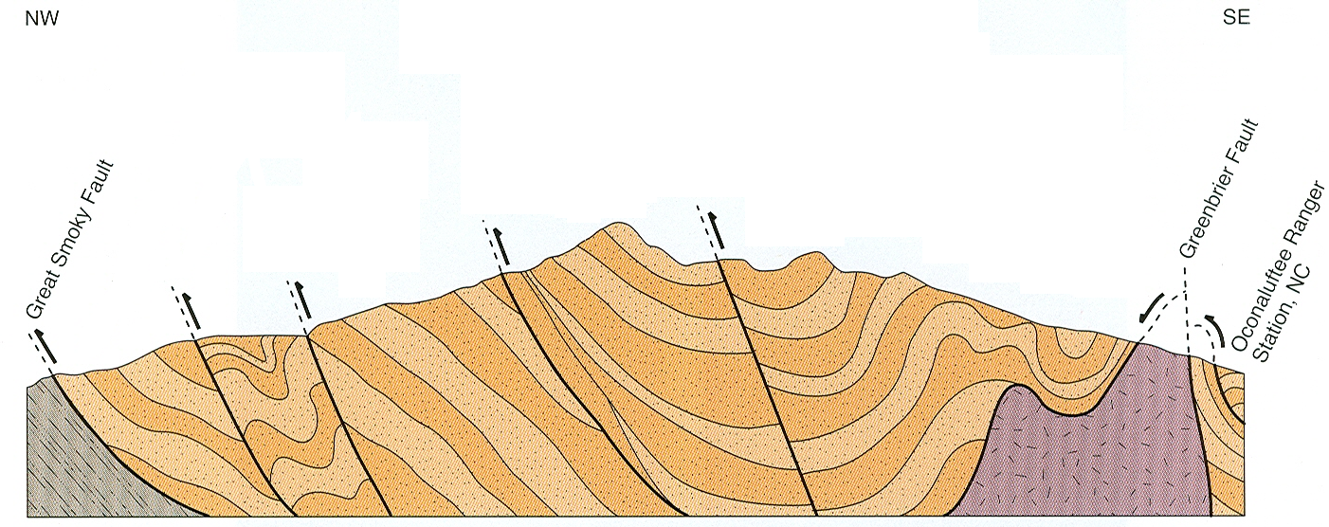
Overturned Anticline
Metamorphosed basalt
Paleozoic sedimentary rocks
Gneiss and granite
Highly deformed Syncline
Notes:
Rocks of similar ages and types occur in Great Smokey National Park, where they form a much larger and more highly deformed syncline…

Slide 27
Overturned Anticline
Metamorphosed basalt
Paleozoic sedimentary rocks
Gneiss and granite
Highly deformed Syncline
Proterozoic sedimentary and metamorphic rocks
Notes:
… with a different and much thicker sequence of Proterozoic sedimentary and metamorphic rocks in its core. Notice, however, that the Proterozoic gneiss and granite basement has limited exposure in the Smokey's, but is relatively well exposed in Shenandoah.

Slide 28
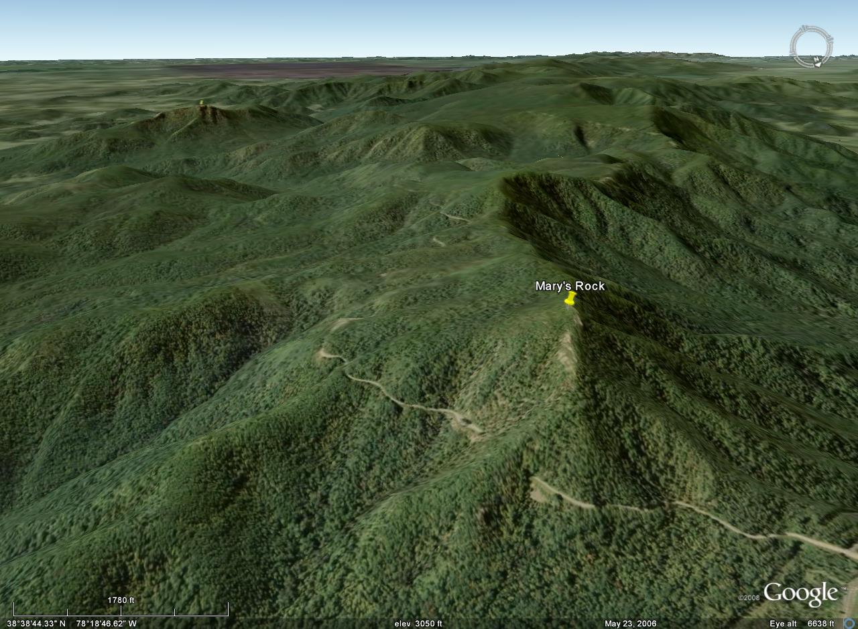
Shenandoah National Park
Old Rag Mountain
Mary’s Rock Tunnel
Notes:
The Shenandoah Blue Ridge exposes these rocks on several of its peaks – such as Mary’s Rock and Old Rag Mountain. Just below Mary’s Rock is Mary’s Rock Tunnel where motorists on famous Skyline Drive….

Slide 29
Notes:
… are greeted with an official park service sign proclaiming the 1.3 billion year age ….

Slide 30
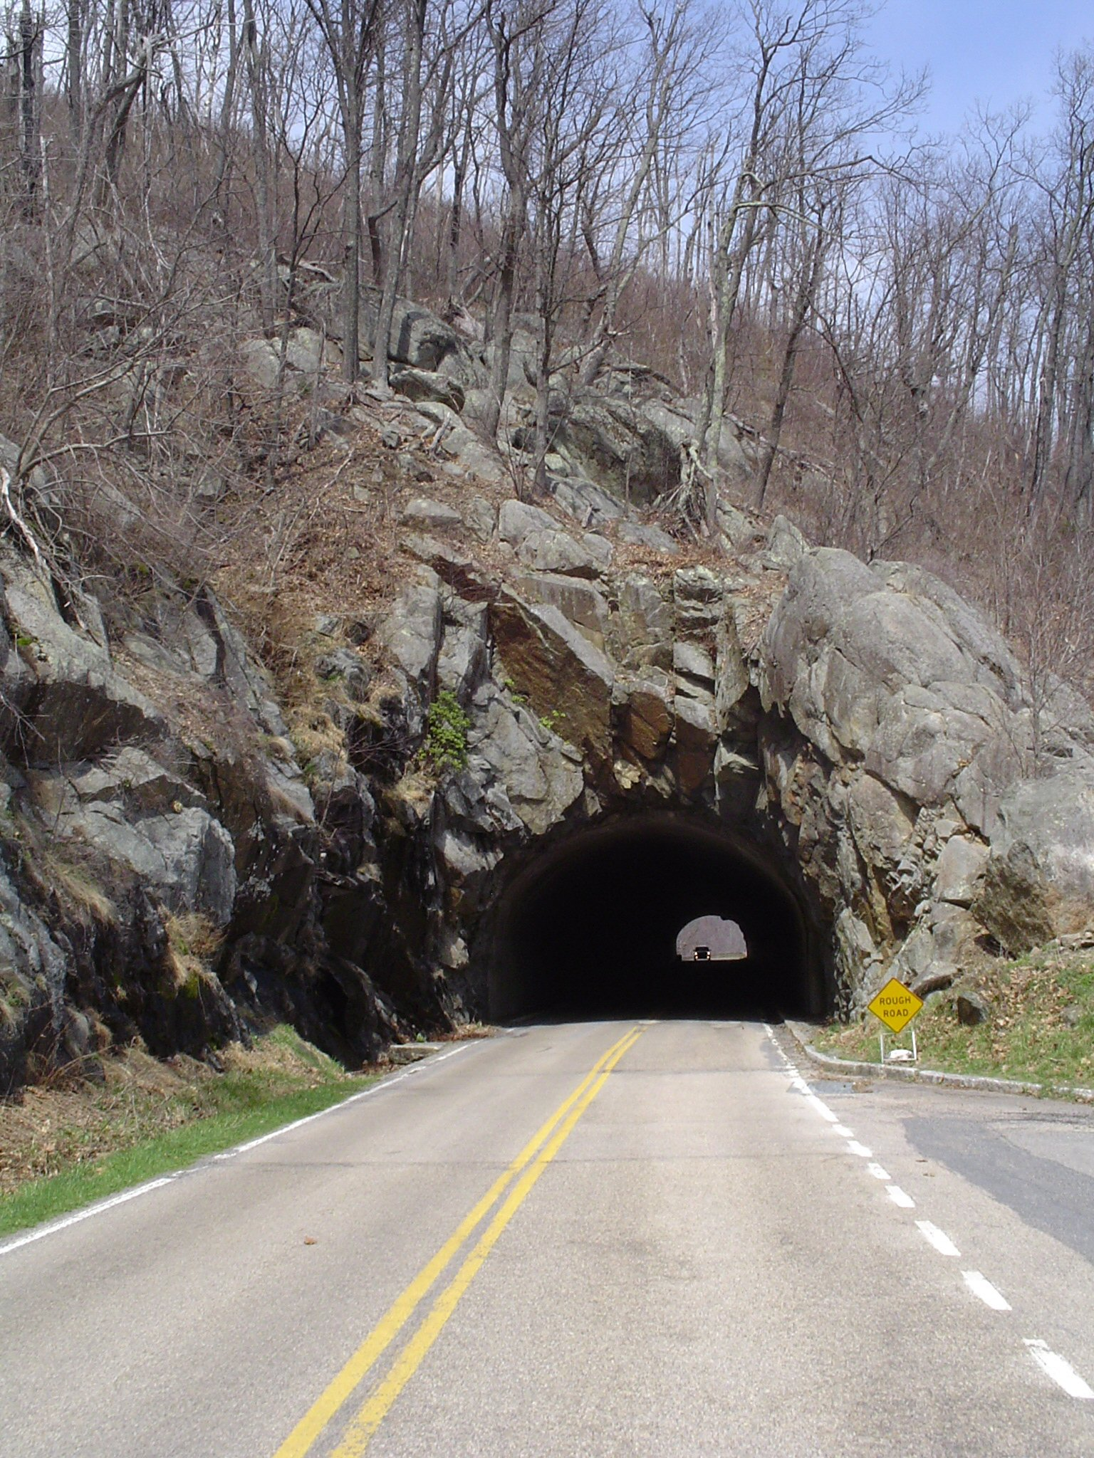
Mary’s Rock Tunnel Granodiorite gneiss (Pedlar Formation)
Notes:
… of the Pedlar Formation.

Slide 31
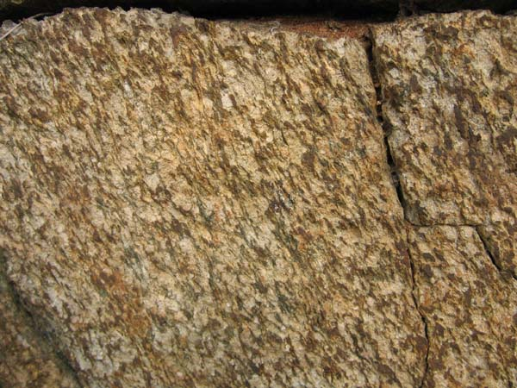
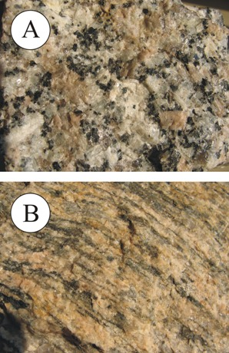
Pedlar Formation
Notes:
The Pedlar Formation is a granite gneiss, which is a compositionally-banded metamorphic rock formed by the intense compression and heating of granite (A). In this case the gneiss records the grand Proterozoic collisions between North America and Africa that created the supercontinent of Rodinia.

Slide 32
Notes:
Known as the Grenville Orogeny, this “event” first involved various subduction orogenies that produced granite batholiths. The orogeny culminated in the thrusting of Africa onto North America, which compressed and buried the granite batholiths, metamorphosing them into granite gneiss.

Slide 33
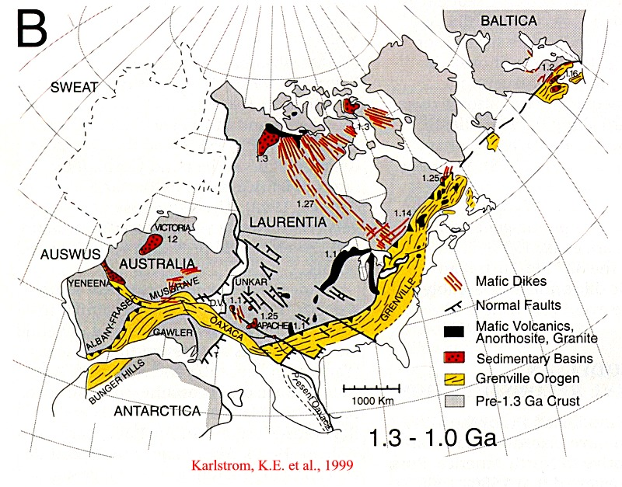
Notes:
Grenville rocks outcrop discontinuously along a belt that extends from southern Scandinavia, to Great Briton, Labrador, throughout Appalachia, portions of the southern and southwestern states and possibly into Australia and Antarctica. They are the oldest rocks along the east coast and have had a long, complex history that culminated in the Grenville orogeny about 1.1 billion years ago.

Slide 34
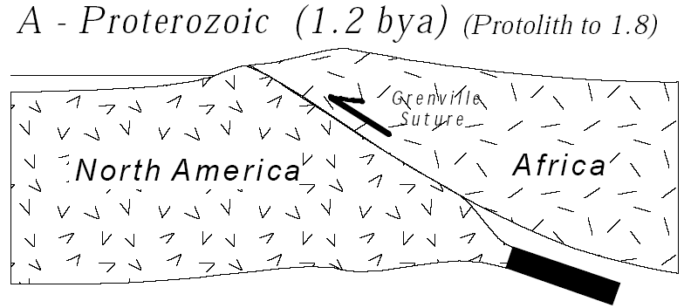
Cross Section A The Grenville: A Major Mountain Building Event Late Proterozoic; 1.8 - ~1.1 bya
Notes:
After the bulk of the Grenville compressional deformation had ended …

Slide 35
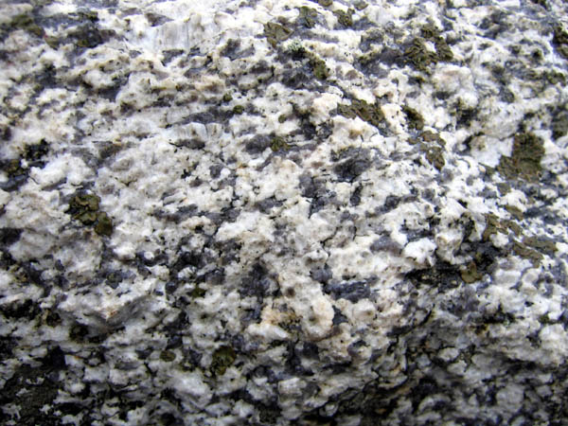
Old Rag Granite
Notes:
… the Old Rag granite was intruded. Notice that it is not foliated like the Pedlar Formation - clearly indicating that it was intruded into the previously deformed Grenville crust.

Slide 36
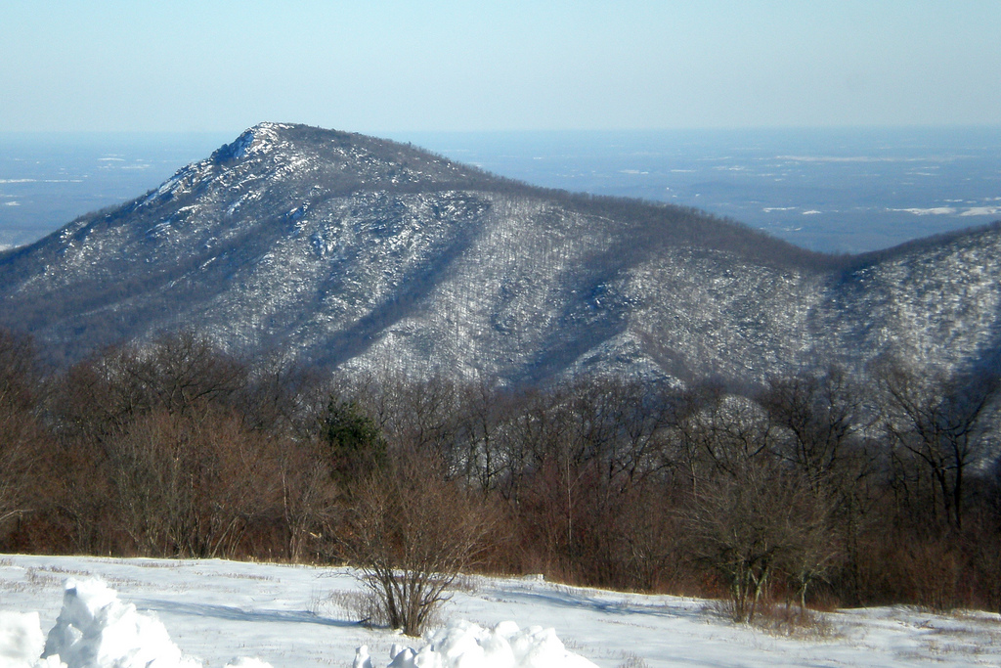
Old Rag Mountain
Notes:
Old Rag Mountain is the type locality for the Old Rag Granite and is one of the most popular hikes in all of Appalachia.

Slide 37
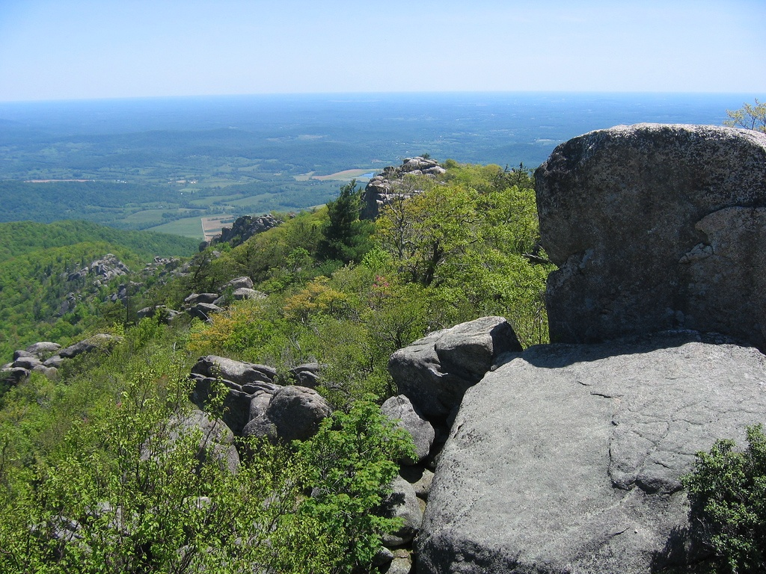
Coastal Plain
Piedmont
Notes:
Not only does the summit provide a wonderful eastward vista across the Piedmont and Coastal Plain, …

Slide 38
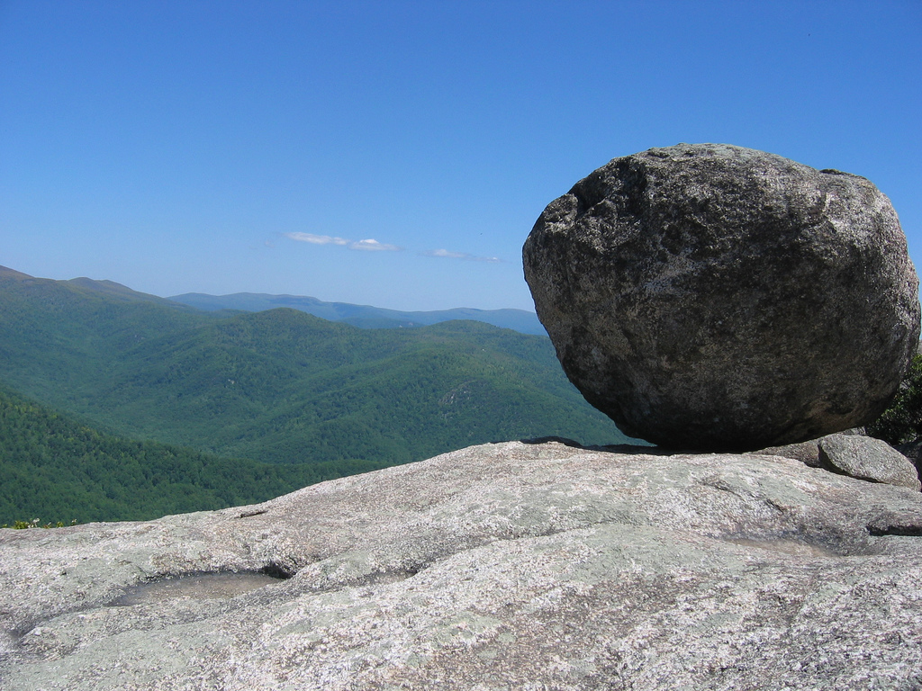
Notes:
… but the exceptionally clean outcrops here offer rock lovers of all types….

Slide 39
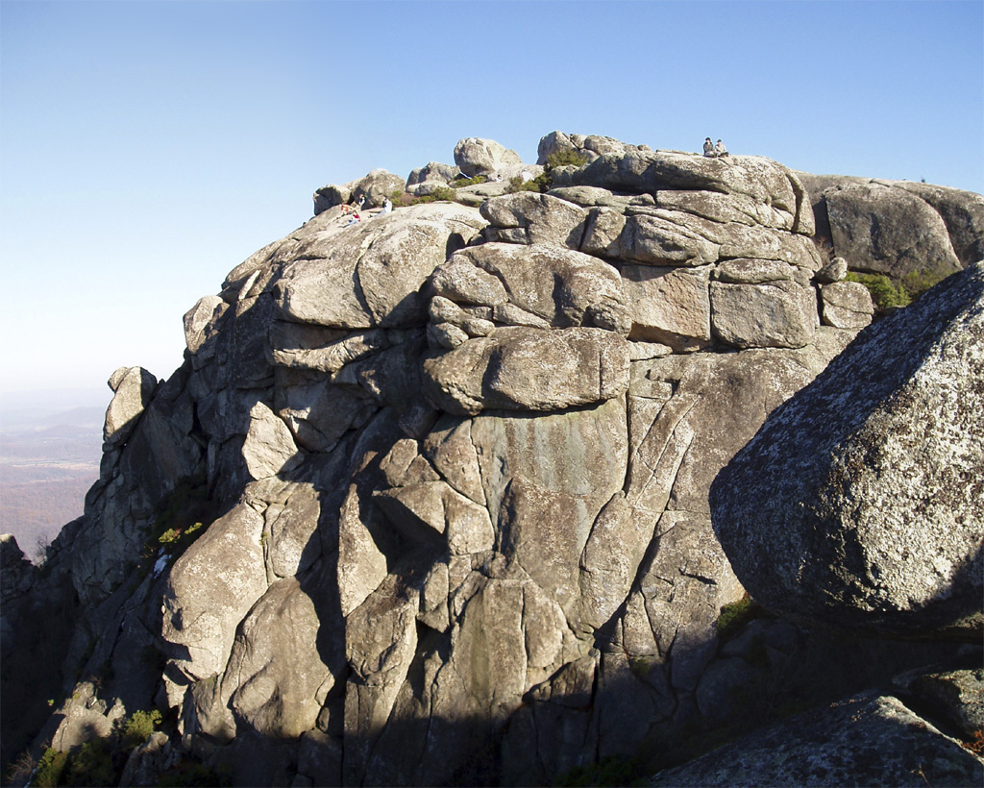
Notes:
… a rare respite from the usual east-coast “tyranny of green”.

Slide 40
Southern Appalachian Mountains
Marshak, EARTH (Norton, 2005)
Parks and Plates
©2005 Robert J. Lillie
Notes:
Recall that the Blue Ridge rocks where thrust up and over the Paleozoic sedimentary rocks of the Valley and Ridge province.

Slide 41
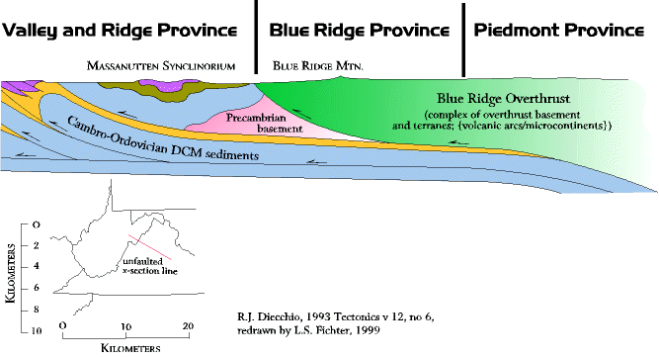
Blue Ridge Fault
Notes:
The thrust fault, known as the Blue Ridge fault, lies at the base of the “Blue Ridge Overthrust" – a massive complex of Blue Ridge basement rocks and various tectonostratigraphic terranes in the Piedmont Province.

Slide 42
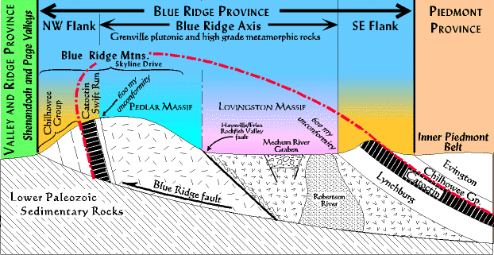
Notes:
As the Blue Ridge Overthrust pushed westward along the Blue Ridge Fault, it folded into a great overturned anticline with younger sedimentary and volcanic rocks flanking its sides. In Virginia these are represented by the Lynchburg, Swift Run and Catoctin Formations and the Chilhowee Group. Because these rocks where deposited directly atop the Pedlar Formation and Old Rag Granite which were once buried deeply under a Grenville-age mountain range of Himalayan scale, we know that there must have been a period of deep erosion that took place after these rocks formed. Since the oldest of the post Grenville surface rocks deposited about 600 million years ago, those mountains had about a half a billion years to wear down.

Slide 43
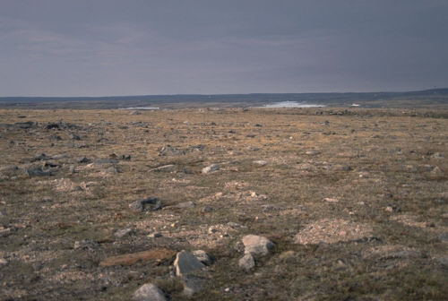
Great Smokey
Shenandoah
Acadia
Closing
Collision Orogeny
Peneplanation
Notes:
Since it only takes about 20 million years for a mountain range to be eroded after orogeny ends, there was more than enough time for the Grenville mountains to be replaced by a vast peneplain.

